Slide 1
Introduction to Object-Oriented Design for Scientists
RSE Webinar – August 29th, 2018
Notes:
Explain that you can take questions in the middle of the presentation, as long as we can keep it short. Otherwise, after presentation.
Welcome everyone and thanks RSE and Andy for the opportunity.
I collaborated with professors from OR department and see that when we adopt SE techniques in these areas when developing software, it really helped. Actually, we continue collaboration and try to impact on coding practices in this field.
This presentation, I hope it will be helpful for you to spark interest in object oriented design because we have seen many benefits by adopting it.

Slide 2
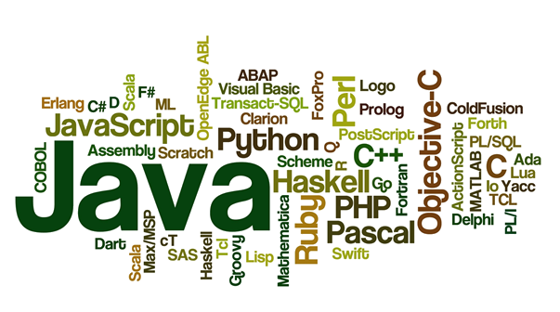
Programming Languages
Notes:
We have lots of programming languages nowadays. Mostly general purpose languages, meaning that anything can be implemented with them. And some specialized languages for specific topics, like mathlab, R etc.
The thing is not about which language we choose. It is about the complexity of the programs we create.

Slide 3

A Non-Complex Program
Notes:
A program is simple when it is short and small.

Slide 4
How about longer ones?
Chrome browser: 17 millions LOC (lines of code)
Office 2013: 45 millions LOC
Facebook: 60 millions LOC
Notes:
One can’t just put all the lines sequentially and expect someone to understand it.
First of all, it is impossible.
Second of all, it is torture.

Slide 5
There are some solutions…

Slide 6
When things get bigger → Modularize
Notes:
We can modularize by using functions. Grouping some of the stuff.
So our programs will be more understandable.

Slide 7
Modularize even more…
And use parametrized version whenever needed.
Notes:
We can go even further and make more modular by creating parametrized functions.

Slide 8
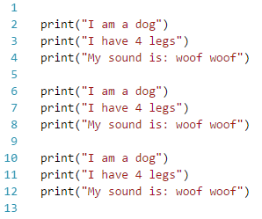

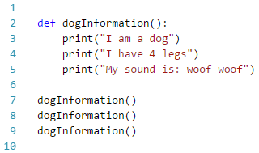
Modularizing
Notes:
Now you may be thinking… enough of the lines, give me something concrete…
Now I want to do this 3 times. Of course the solution is this, right [CLICK]
I think we should be smarter than that. [CLICK]

Slide 9
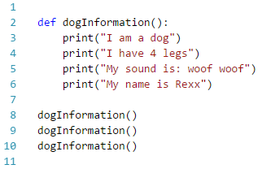
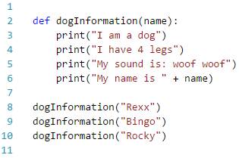
Modularizing - Parametrized
Notes:
Now let’s add more of the dog’s attributes. Now we also want to write the dog’s name.
Of course not all dogs are Rexx, so here it is.

Slide 10
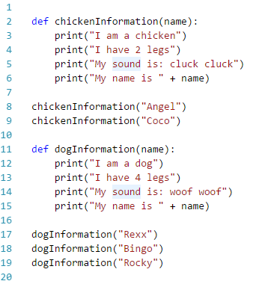
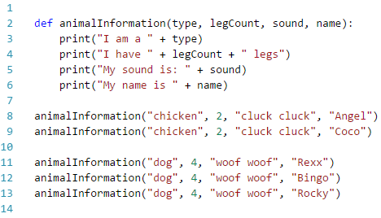
Modularizing – More parametrized
Notes:
Now I want to print another animal information
[CLICK] Tadaa chicken
But I didn’t like something in this code.
We have a lot of repetition here and here. [SHOW: I am I have My name is]
[CLICK] Now it is better
But still, why should I write 2 or 4 everytime? Or Woof woof or “dog” in that sense.

Slide 11
Epiphany
Wouldn’t it be nice if there is special structure that:
Knows what kind of an animal it is.
Knows how many legs it has.
Can make sound by itself.
Has a name.
Notes:
So that I don’t need to write everything down from scratch every time I need a dog.

Slide 12
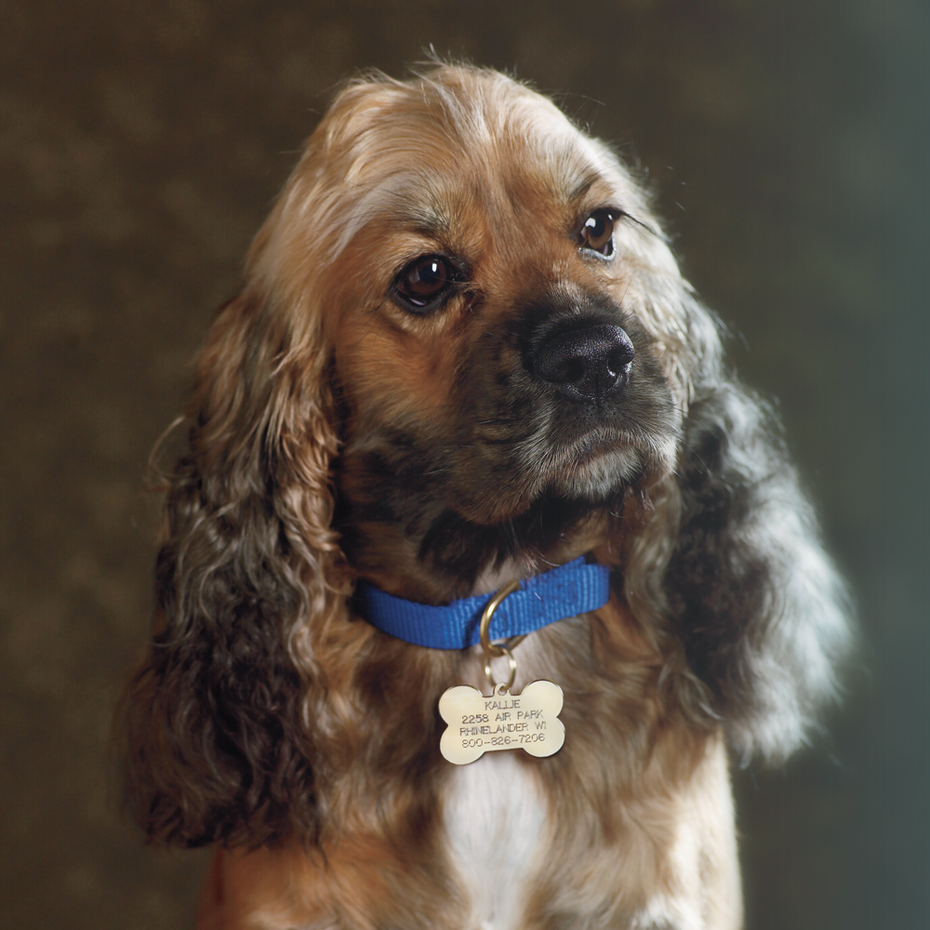
Epiphany
Notes:
So we are basically talking about a dog?
Has name, knows how many legs it has, can make sound itself.

Slide 13
In object-oriented design, we are copying the real life structure in our application.
Notes:
And this is for a very good reason.

Slide 14
Harold Abelson In his book SICP: Structure and Interpretation of Computer Programs (with Jay Sussman)
First, we want to establish the idea that a computer language is not just a way of getting a computer to perform operations but rather it is a novel formal medium for expressing ideas about methodology.
Thus, programs must be written for people to read, and only incidentally for machines to execute.
Notes:
So actually, we are writing the programs for ourselves. The computer will do whatever it is given as an input.
It doesn’t need to have meaningful names, functions, classes, objects, variables. It just needs some instructions. Languages are for us!

Slide 15
Epiphany
Wouldn’t it be nice if there is special structure that:
Knows what kind of an animal it is.
Knows how many legs it has.
Can make sound by itself.
Has a name.
Object-Oriented Design
Notes:
So we had this epiphany, and the system we are looking for is object-oriented design.
A.k.a.
Object-oriented programming
Object-oriented methodology
Object-oriented paradigm
Object-oriented design and analysis

Slide 16
Object-oriented design
Side
Area = side*side
Height
Base
Area = (height*base)/2
height
Side
base
Notes:
Basically, we have objects that know:
Their attributes
Their operations
Whenever, I need a square or triangle, I will use them and ask them.

Slide 17
Object identification
Car, glass, bike, bus
Dog, cat, person, laptop
Running, walking, making a sound etc… ?
Side, height, numberOfLegs etc… ?
Notes:
[CLICK] All can be objects
[CLICK] Again, can be objects
[CLICK] No, these are not objects!
These are actions (methods/operations) that can be done by an object
Like a Rectangle can compute its own area
A people can run.
[CLICK] No, these are not objects!
These are properties (attributes) that can be owned by an object
Like side of a Rectangle.
Numberoflegs of a Person.

Slide 18
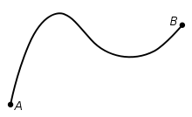

Everything can be an object…
It just depends on the context!
Distance between two cities can be an object
Relationship between two people can be an object

Slide 19
Object-oriented languages
Most modern languages support object-orientation now
Java
C++ (C with classes)
C#
Python
Even Fortran
Any many more

Slide 20
Now, various languages support object-orientation, there should be a way to represent this system regardless of the language we use.

Slide 21

UML

Slide 22
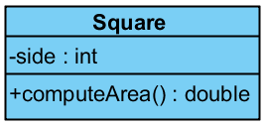
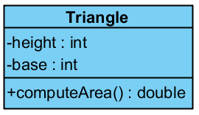
UML Basics
Side
Area = side*side
Side
Height
Base
Area = (height*base)/2
height
base

Slide 23
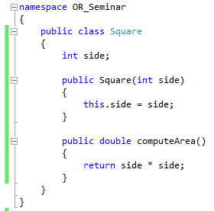
Class in C#

Slide 24

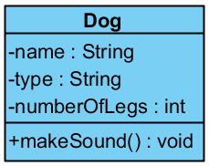


WAIT!
We were talking about objects, now what the heck is a class?
Notes:
Basically, we get the properties that all the dogs have and define a Dog class with them.
A class is a generalization of objects.
And objects are just instances of the class.

Slide 25
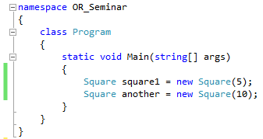
Objects from classes
Constructor
Now, we can create objects

Slide 26
Concepts and design principles in OOD
Concepts:
Encapsulation
Inheritance
Polymorphism
Cohesion
Coupling
Principles
Open-closed principle
Don’t repeat yourself principle
Single Responsibility principle
Liskov substitution principle
Interface segregation principle
Dependency inversion principle
Notes:
If we don’t use these concepts and obey these principles, we aren’t coding in proper object-oriented way.

